Slide 1

B2Bi Basics eLearning
Message Processing Part 6
B2Bi Basics
Notes:
Welcome to Module Six: Message Processing in B2Bi.

Slide 2

Learning Objectives & Introduction
B2Bi Basics: Message Processing Part 6
B2Bi Basics
Notes:
In this chapter, we will review the key items and learning objectives for this module.

Slide 3

Message Exchange Part 1 – Overview
Items
Metadata Profiles
Metadata Services
Notes:
This module covers Metadata Profiles and Metadata Services.

Slide 4
Module Objectives
After completing this module, you will be:
Familiar with the concept of Metadata-based processing and the configuration and creation of Metadata Profiles and Services
Notes:
After completing this module, you will be able to perform routing and processing based on metadata, rather than message content. The key components required are Metadata Profiles and Metadata Services.

Slide 5
General B2Bi Processing Pattern
1
Pickup (Application/Trading)
Message Handler
Metadata Matching
4
Pickup (Consumption)
  From partner
    Delivery to Application
  From Application
    Delivery to Application
    Execute Service
Optional Metadata Profile phases
  Execute a series of MDPs
  Change Message or Detection Attributes
  Send to Outbound Agreement
  Delivery to Partner or Application
Detection
Agreement handling
  (resolved) Partner to (resolved) Partner
  (optional via Service) to Application
Delivery
  To Application
  To Partner
Metadata Profile
2
Service (Metadata)
2
3
Detection Matching
7
Inbound Agreement
4
B2BI Reprocess Message
5
3
Document Agreement
5
6
Service (Partner)
Outbound Agreement
6
Service (opt. Post Enveloping)
8
Message Handler (opt)
8
Collaboration Settings
Delivery Settings
9
9
Delivery (Application / Partner / Sync response)
Service (opt. Post-Transfer)
Notes:
The diagram shows all possible message flows in B2Bi. In this module, we will focus on items 4, 5, and 6: metadata matching, metadata service execution, and subsequent steps such as outbound agreement execution and delivery to an application or partner.

Slide 6
Metadata Profiles & Services
B2Bi Basics: Message Processing Part 6
B2Bi Basics
Notes:
(No notes)

Slide 7
Message Processing Logic
Depending on metadata or content criteria, B2Bi can execute:
Message Handler processing in the Trading Engine
Configured through Message Handler rules – restricted to basic routines. See “B2Bi Basics – Message Exchange Part 3”.
Message Processing in the Integration Engine
Partner based – using information from the “content” of the message (payload). See “B2Bi Basics – Message Processing Part 2”
Metadata based – using information from the “context” of the message (metadata)
Processing logic based on configured metadata criteria.
Example: If filename extension is “zip” then B2Bi will execute an unzip routine.
Notes:
B2Bi can process messages using metadata or content-based criteria, such as:
Message Handling Rules, which was covered in Message Exchange Part 3.
Partner Services which was covered in Message Processing Part 2.
And Metadata Services, which is covered in this chapter.
With metadata-based processing, you can perform various operations within a service, specifically a Metadata Service.
Example:
A Metadata Profile might filter files with the .zip extension, and the corresponding Metadata Service could unzip those files.

Slide 8
Context/Metadata-based Processing
To configure Context/Metadata-based processing rules, two key objects need to be defined in B2Bi:
Metadata Profile, holds the “Criteria” that must apply to incoming message.
Metadata Service, contains the logic that must be applied to a certain message
Metadata Services are connected to a Metadata Profile definition
Metadata Profile condition: filename extension matches “.zip”
Metadata Service logic: execute component that decompresses the incoming file.
Notes:
To use metadata-based processing, you must configure two objects: a Metadata Service and a Metadata Profile.
The Metadata Profile specifies the criteria for executing the service.
The Service defines the logic to be executed.
Tip:
Create the service before the profile, as the profile references the service.
Examples:
A profile that filters files with the .zip extension, with a service to decompress them.
A profile that detects inbound EDIFACT messages from a specific partner (who always adds new lines), with a service to remove those new lines before processing.

Slide 9
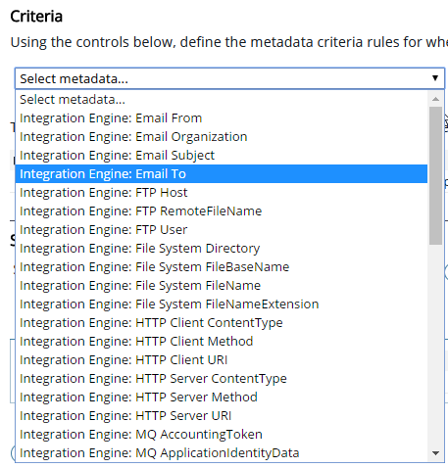
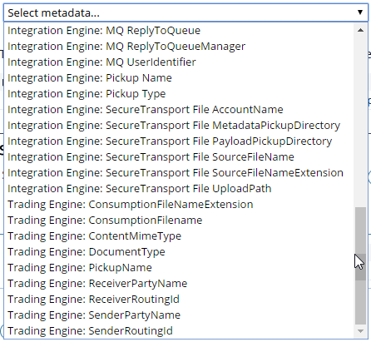
Metadata Profile Criteria
Metadata Profile criteria rules are based on information from 2 “sources”:
  Metadata information produced by the Trading Engine
  Metadata information produced by the Integration Engine
Trading Engine criteria are the “standard”
Integration Engine criteria are only available if a Integration Engine Pickup is involved in the exchange.
The list with criteria can be extended manually with custom criteria. The user must make sure the selected attribute gets produced.
Alter $B2BI_SHARED_LOCAL/config/b2bx/server/metadata_attributes.cfg
Notes:
When configuring metadata profiles, you can select criteria based on Trading or Integration engine pickup metadata.
Trading engine criteria are standard.
Integration engine criteria are available only if the Integration engine pickup is installed.
You can manually extend the list of criteria with custom attributes (e.g., PeSIT details).
Attributes must be populated at runtime to match during profile selection.
Default criteria location:
$B2BI_SHARED_LOCAL/config/b2bx/server/metadata_attributes.cfg
To add new metadata, "pesit.callerId.in" for example, edit this file. No restart is required, just reselect the profile and reopen the criteria.

Slide 10
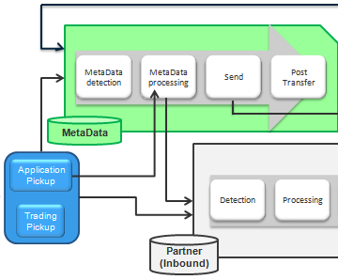
Metadata Detection – Evaluation Order & Lookup
Evaluation Order (Metadata)
  Number of criteria: Three criteria > Two criteria > One criteria
  Equal number of criteria => in alphanumeric order!
Notes:
In the B2Bi processing flow, pickups (trading or application) are routed to Metadata Detection, which may trigger metadata processing.
Subsequent steps can include:
Transfer to a partner with post-transfer.
Detection, processing, then transfer and post-transfer.
B2Bi evaluates every message for metadata content. If a message contains an attribute matching a metadata profile, the specified processing is applied.
Key points:
Metadata profiles apply to all messages matching their conditions.
When using metadata profiles, only metadata attributes are considered—not message content.
Matching order:
Number of criteria matched.
If equal, alphabetical order of profile name.

Slide 11
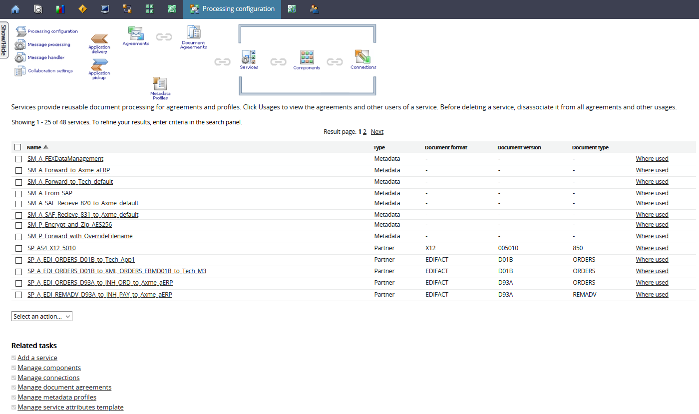
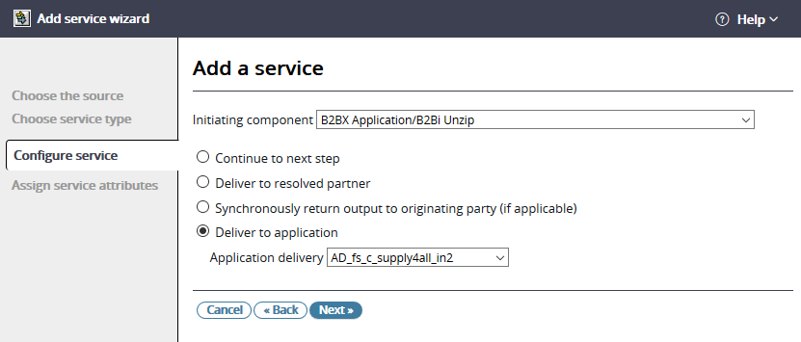
Manage Metadata Service
Add a Service – Metadata
Continue to next step: After the service execution output will pass to a new detection process.
Deliver to resolved partner: Output will be delivered to the partner.
Synchronously return output to originating party: used for Web Service provider mode.
Deliver to Application delivery: Output will be delivered to an Application delivery.
Notes:
To add a metadata service:
Select "Add a service" and choose the initiating component (e.g., unzip functionality).
Components must be created before selection.
Define the service output, which can be:
Continue to next step (passes output to new detection).
Deliver to resolved partner.
Synchronously return output to originating party (for Web Service provider mode).
Deliver to application.

Slide 12
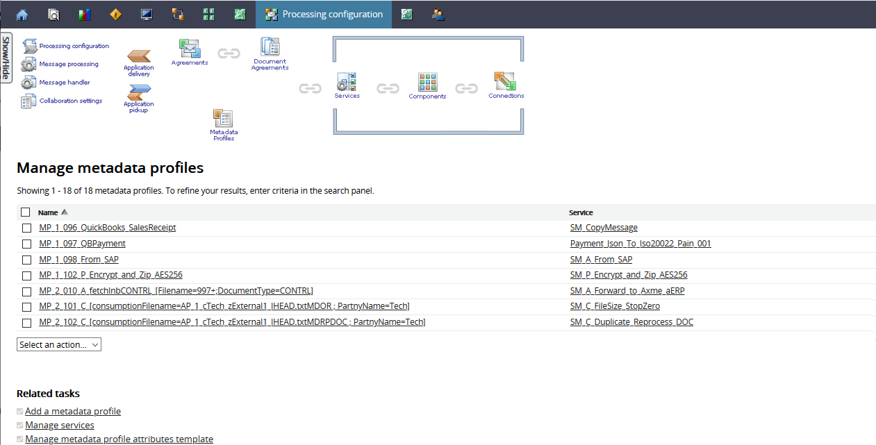
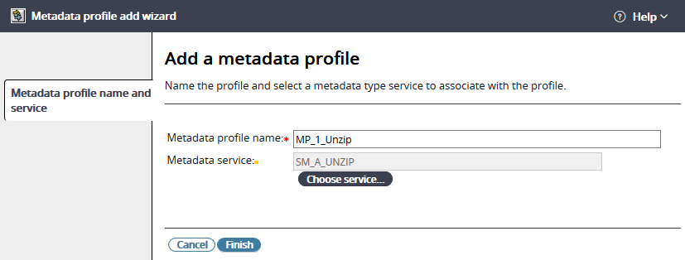
Manage Metadata Profiles
Add a Metadata Profile from Processing configuration
Notes:
After creating the metadata service, create the metadata profile:
Go to "Processing configuration" and select "Manage Metadata Profiles."
Choose "Add a metadata profile" from related tasks.

Slide 13
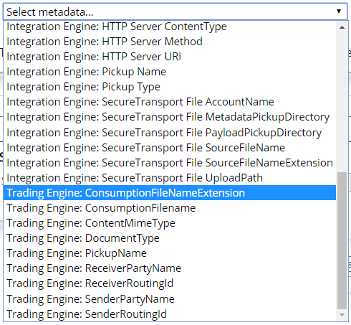
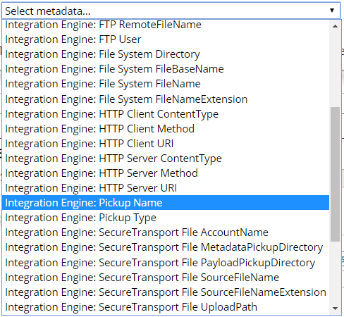
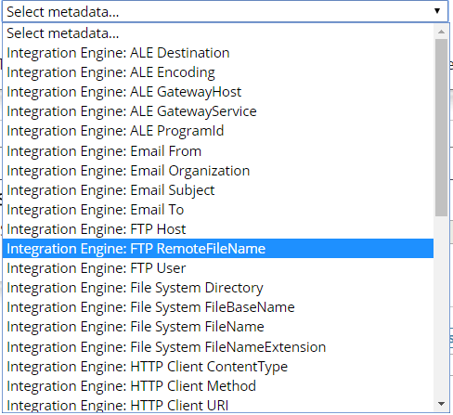
Detection - Different Metadata Attributes to Catch
[Trading Engine]
Prefix:
Trading Engine
[Integration Engine]
Prefix:
Integration Engine
Notes:
To assign selection criteria in the metadata profile:
Click the list and browse using the drop-down menu.
Prefixes indicate which engine (integration or trading) the metadata applies to.

Slide 14
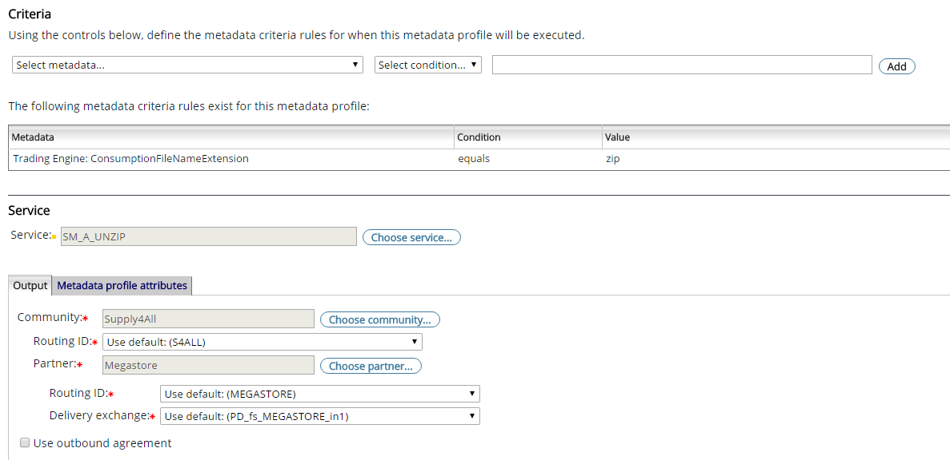
Detection – Metadata Service – Output: Deliver to Resolved Partner
Hard coded delivery parameters
- Community + Routing ID
- Partner + Routing ID
- Transport Protocol Delivery
Notes:
When creating the metadata profile, select one or more metadata elements to match values.
Possible conditions: equals, not equals, starts with, ends with, contains, matches.
If the service output is "deliver to resolved partner," configure the community, partner, routing ID, and delivery exchange.

Slide 15
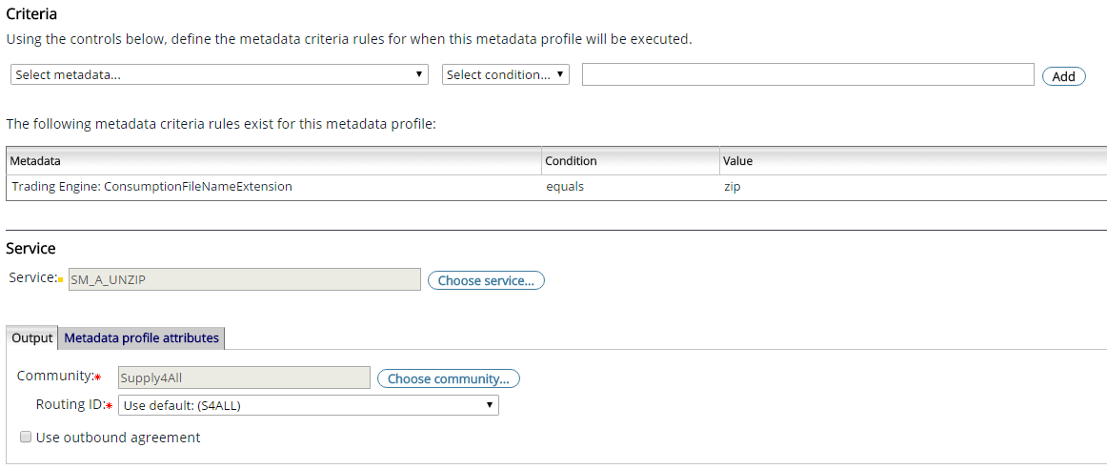
Detection – Metadata Service – Output: Application Delivery
Hard coded delivery parameters
- Community + Routing ID
Notes:
If the service output is "deliver to application," you can set the originating community and routing ID.
For PeSIT transfers, always specify the "To" and "From" PeSIT Identifiers.

Slide 16
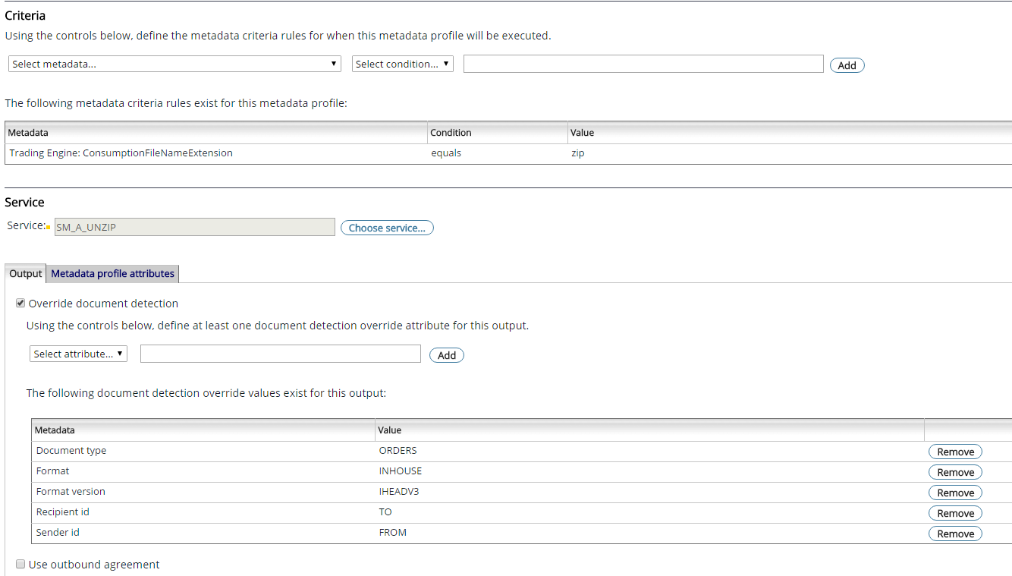
Detection – Metadata Service – Output: Continue to Next Step
Notes:
If the service output is "continue to next step," the message can undergo further detection (e.g., additional Metadata or Agreement Detection).
Example:
First, detect a zip file and unzip it. Then, detect the sender (e.g., ACME), who uses EBCDIC encoding, and convert to ASCII before Agreement Detection.

Slide 17
Detection – Metadata Service – Output: Continue to Next Step
(using ”Override document detection”)
The content based DIP is injected but since the detection values already exist, the detection phase is by-passed and will use these values instead
Either all five have to provided or just one (the format)
Notes:
As an advanced option, you can assign attributes for subsequent detection using "Override document detection."
Specify values for Document Type, Format, Format Version, Recipient ID, and Sender ID as needed.

Slide 18
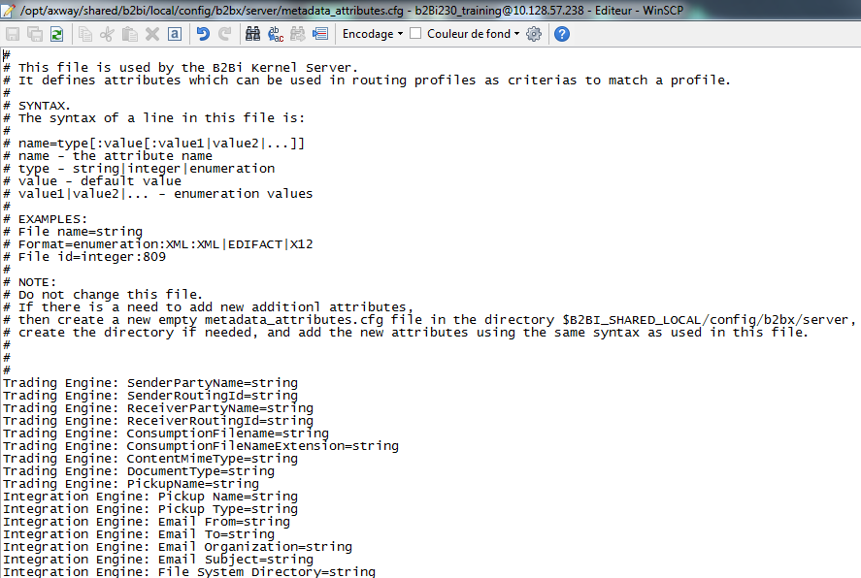
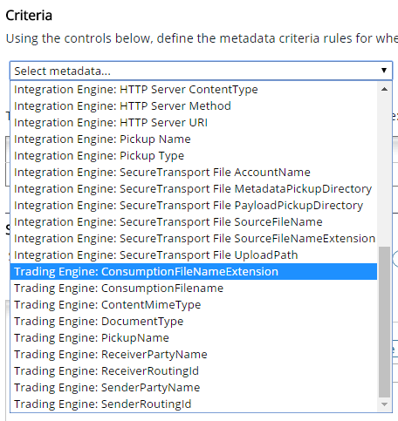
Detection – Metadata Service – Adding Customized Attributes Configuration
In $B2B_SHARED_LOCAL/config/b2bx/server, create or alter file named metadata_abtributes.cfg
Edit file metadata_attributes.cfg
Located in the shared folder
Add Attribute & Prefix
Save and refresh the MD profile
Notes:
You can extend the list of metadata used in profile criteria by editing the metadata_attributes.cfg file in B2B_SHARED_LOCAL/config/b2bx/server.
Tip:
Use the exact names as shown in the metadata tab in Message Tracker, and pay attention to case sensitivity.

